Slide 1
PYTHON
Module 1
An Introduction to Python
Presentation by: Gopinath.G

Slide 2
Module 1: An Introduction to Python
• What can Python do?
• Why Python?
• Good to know
• Python Syntax compared to other programming languages
• Python Install Module

Slide 3
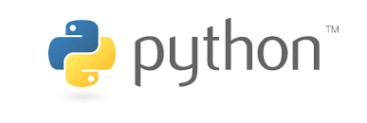
What is python ?
Python is a high-level, interpreted, and general-purpose programming language. It was created by Guido van Rossum and first released in 1991. Python emphasizes readability, simplicity, and ease of use, making it a popular choice for beginners as well as experienced developers.

Slide 4
What can Python do?
Python is an incredibly versatile programming language with a wide range of applications
1. web development
2. Data science and machine learning
3. Game development
4. Cybersecurity
5. IoT (INTERNET OF THINGS)
6. Robotics
7. Cloud Computing
8. Database access
9. Ethical Hacking

Slide 5
Good to Know
Readability
Interpreted Language
High level language
Dynamic typing
Object oriented programming
Extensive libraries
Cross platform
Open source

Slide 6

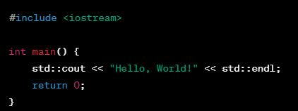
Python Syntax compared to other programming languages
Python is an easily adaptable programming language that offers a lot of features.
1. Python programming Hello world
2. C++ programming Hello world

Slide 7
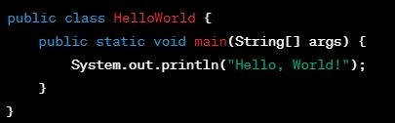
Python Syntax compared to other programming languages
3. Java programming Hello world

Slide 8
Python Install Module
1. Download Python Installer:
Visit the official Python website: Python Downloads.
Click on the "Downloads" tab, and select the version that corresponds to your operating Once the installer is downloaded, run the executable file.
Make sure to check the box that says "Add Python to PATH" during installation.
2. Run the Installer
3. Install Python
4. Verify Installation:
Open a Command Prompt and type python --version or python -V to check if Python is installed and to see the installed version.
You can also run python to enter the Python interactive shell.

Slide 9
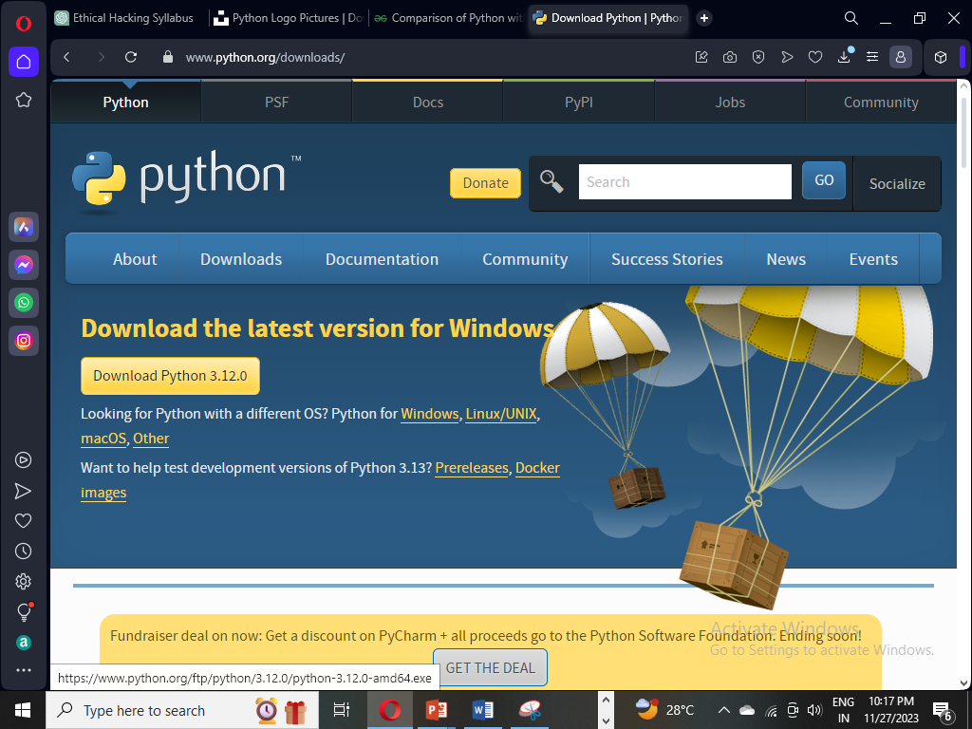

Slide 10
THANKYOU..!

